Slide 1


Introduction to Single-Cycle MIPS Processor
The single-cycle MIPS processor is a fundamental computer architecture that executes instructions in a single clock cycle. It forms the basis for understanding more complex processor designs and is crucial for implementing algorithms like selection sort.

Slide 2
Team Members
كريم اسامة السيد عبد الرحمن
مصطفى حسن جاب الله عطية محمود
مصطفى المهدى أحمد عطوة
سامح سامى كمال غطاس
عبد الرحمن منصور السيد منصور

Slide 3
Instruction Types: R-type, I-type, and J-type
R-type
I-type
J-type
Register-based instructions that perform arithmetic and logical operations.
Immediate-based instructions that load, store, and branch data.
Jump instructions that change the control flow of the program.

Slide 4
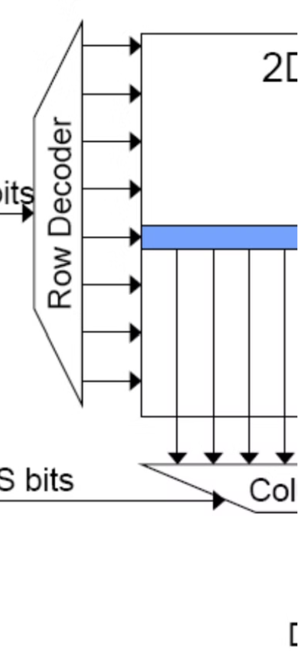
Memory Initialization and Data Representation
1
Initialize Memory
2
Data Representation
Load unsorted data into memory regions accessible by the MIPS processor.
Understand how integer data is stored and manipulated in the MIPS architecture.
3
Memory Addressing
Utilize the MIPS addressing modes to access memory locations efficiently.

Slide 5
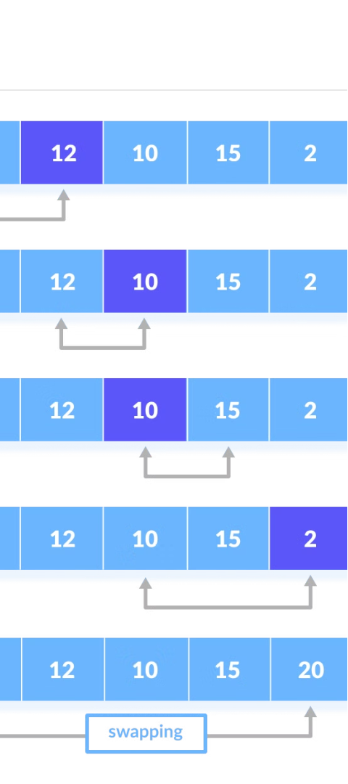
Selection Sort Algorithm Overview
1
Find Minimum
Scan the unsorted portion of the array to find the minimum element.
2
Swap Elements
Swap the minimum element with the first element of the unsorted portion.
3
Repeat
Repeat the process until the entire array is sorted.

Slide 6
Implementing Selection Sort in MIPS Assembly
Load Data
Find Minimum
Load the unsorted array data from memory into registers.
Iterate through the unsorted portion to identify the minimum element.
Swap Elements
Repeat
Swap the minimum element with the first element of the unsorted portion.
Repeat the process until the entire array is sorted.

Slide 7
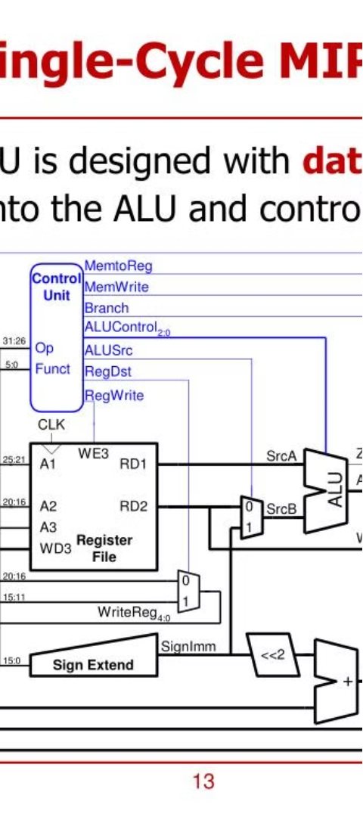



Executing the Selection Sort on the Single-Cycle MIPS
Fetch
Fetch the next instruction from memory.
Decode
Decode the instruction to determine the operation and operands.
Execute
Execute the instruction and update the processor state.

Slide 8



Performance Analysis and Optimization Opportunities
Cycle Time
Memory Access
Parallelism
Analyze the impact of instruction execution time on overall performance.
Explore ways to optimize memory access patterns for better efficiency.
Investigate opportunities for exploiting instruction-level parallelism.

Slide 9
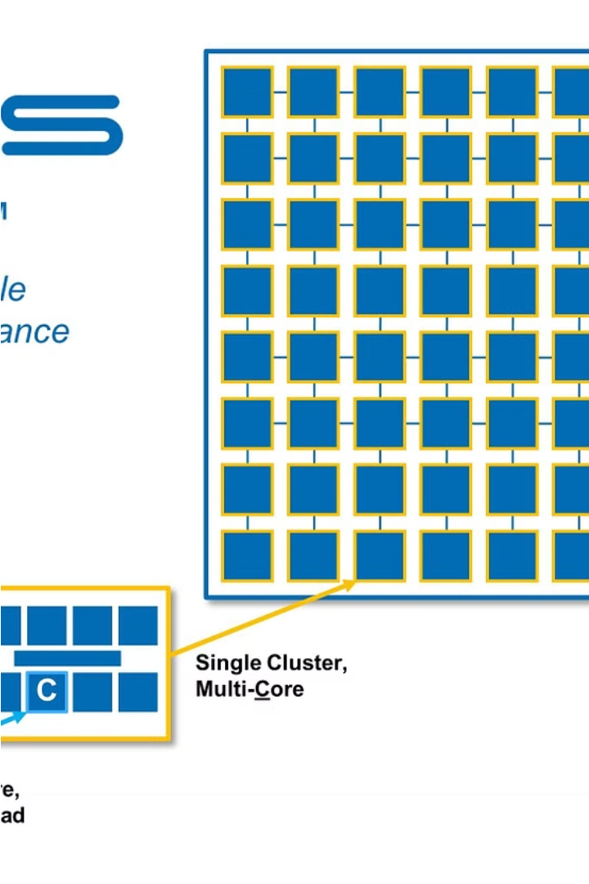
Conclusion and Future Considerations
The single-cycle MIPS processor provides a solid foundation for understanding more advanced computer architectures. Applying algorithms like selection sort helps reinforce the concepts and highlights areas for potential optimization.

